Slide 1
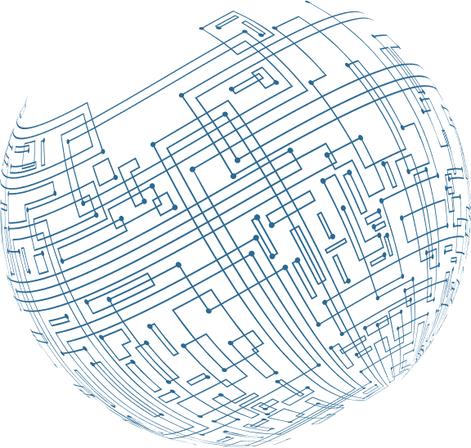



Web applications
Project

Slide 2
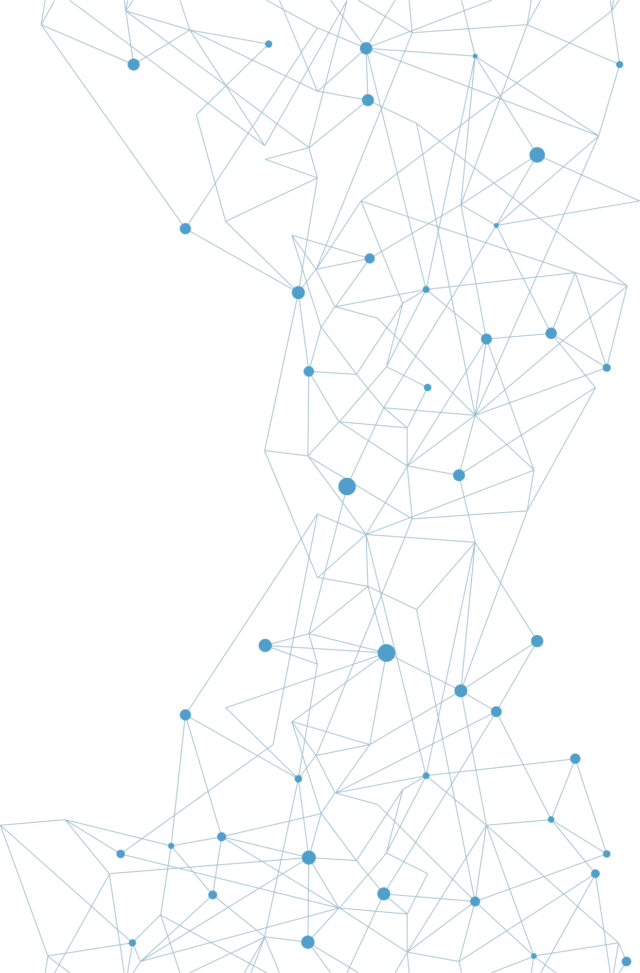
Table Of
Content
Introduction
01.
02. System analysis
03. System specifications
04. Screenshot of the output
05. Source code
06. Conclusion

Slide 3

01. Introduction
to the Weather
Web Application Project
Introduction
With the increasing reliance on technology and the high demand for instant access to information, providing accurate and up-to-date weather data has become crucial. A weather web application is a tool that allows users to easily and efficiently access weather information through their electronic devices.
02. System analysis
APPLICATION features:
03. System specifications
Show current weather: The application displays detailed information about the current weather conditions in the user's geographical location or any other chosen location.
Interactive User Interface: The application is designed to be easy to use and visually attractive, with icons to improve visualization.
Real-time updates: The app relies on global weather services to fetch real-time data, ensuring the accuracy of the information provided.
04. Screenshot of the output
05. Source code
06. Conclusion
Learn More

Slide 4
Technologies
used
01
HTML :
02
CSS
03
JAVASCRIPT:
HTML is used to build the structure of pages and define the basic content of the application.
CSS is used to style the look and layout of the application, including colors, fonts, and layouts.
JavaScript is used to make the application dynamic and interactive, enabling users to receive real-time weather updates.
Learn More

Slide 5

System Analysis
for Weather Web Application
ANALYSIS OBJECTIVES
FUNCTIONAL REQUIREMENTS
NON-FUNCTIONAL REQUIREMENTS
SYSTEM STRUCTURE
USE CASE SCENARIOS
PROJECT GOAL
Display current weather: Display temperature, sky conditions, wind speed, humidity and barometric pressure.
Geolocation: Allow users to manually enter location or use the device's geolocation.
Interactive User Interface: Design an attractive, easy-to-use interface with icons and graphs.
Real-time updates: Fetch and update weather data from global weather services in
real-time.
Performance: Ensure quick response and real-time data updates.
Ease of use: Providing a user-friendly interface with clear navigation.
Availability and Reliability: Ensure that the system is always available and that the data is reliable.
Security: Protection of user data and secure communication with weather services.
User interface (UI): HTML pages, CSS for design, and JavaScript for interactivity.
Weather services interaction: Use APIs to fetch and process weather data.
Data management: storing data temporarily and updating it periodically.
View current weather: Users open the app to see current weather conditions.
View future forecast: Users click on the forecast option to see the weather for the coming days.
Change location: Users enter a new location or use location to update weather information.
This project aims to design a web application to provide updated and accurate information about weather and weather conditions using HTML, CSS and JavaScript technologies. The application aims to provide an intuitive and attractive user interface for users to know temperature, wind speed, humidity and other relevant information.
Determine user requirements.
Determine basic system functions.
Outline of the system structure and its components.
Define interaction interfaces between the user and the system.

Slide 6


System specifications
for the weather web application
FEATURES:
TO SET:
Display current temperature.
Display sky conditions (eg, sunny, cloudy, rainy).
Show wind speed and direction.
Display humidity levels.
Allow manual entry of city or location.
User-friendly and attractive interface design.
Fetch weather data from global weather services (e.g., OpenWeatherMap, WeatherAPI).
Implement a responsive design that adapts to different screen sizes.
Make sure the system is available 24/7.
Ensuring the accuracy and reliability of weather data.

Slide 7

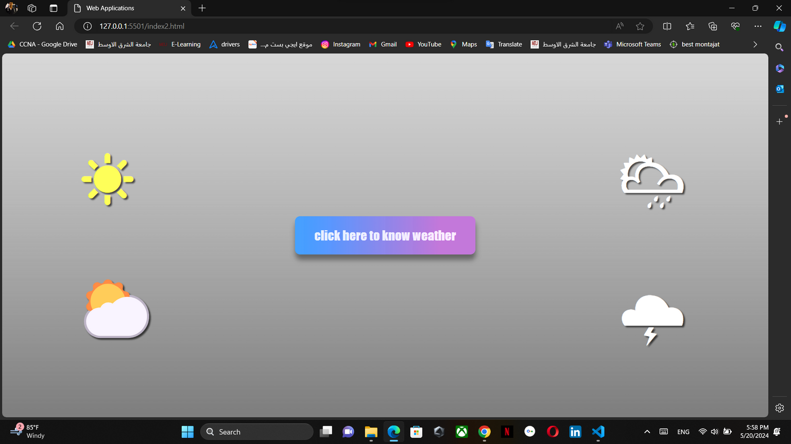
Screenshot
of the output

Slide 8
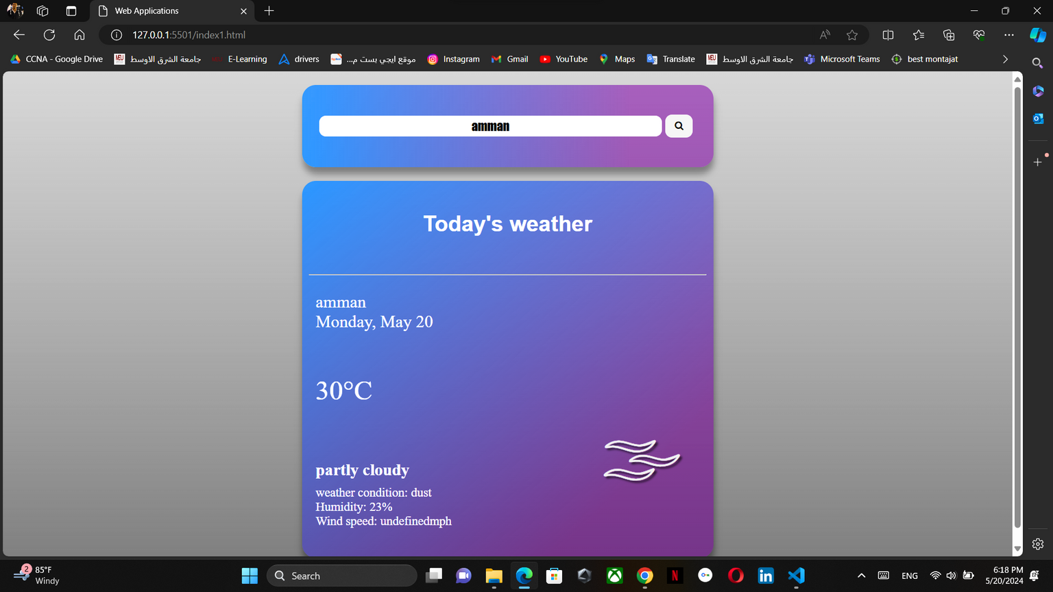
Screenshot
of the output

Slide 9



Source
code
The weather web application fetches real-time weather data using the OpenWeatherMap API, allowing users to receive accurate and up-to date information about current weather conditions and future forecasts.

Slide 10
HTML
*{
padding: 0px;
margin: 0px;
}
.container{
height: 100vh;
background-image: linear-gradient(to top, rgba(0, 0, 0, 0.495) 1%, rgba(192, 192, 192, 0.797) );
padding: 10px;
}
.header{
display: flex;
flex-direction: row;
justify-content: center;
align-items: flex-start;
}
.mainer{
display: flex;
flex-direction: row;
justify-content: center;
align-items: flex-start;
}
.head{
height: 120px;
background-image: linear-gradient(to right,rgba(30, 143, 255, 0.855) ,rgba(137, 0, 178, 0.5) 80%);
border-radius: 20px;
margin: 10px;
flex-basis: 600px;
box-shadow: 1px 10px 10px rgba(0, 0, 0, 0.326) ;
display: flex;
flex-direction: row;
flex-wrap: wrap;
justify-content: center;
align-items: center;
}
.main{
width: 600px;
height: 550px;
background-image: linear-gradient(to bottom right,rgba(30, 143, 255, 0.855),rgba(137, 0, 178, 0.5)80% );
border-radius: 20px;
margin: 10px;
box-shadow: 1px 10px 10px rgba(0, 0, 0, 0.322);
}
.part1{
position: absolute;
top:5px ;
font-size: 25px;
color: white;
transition: 0.5s;
}
.part1:hover{
font-size:32px;
}
.part2{
position: absolute;
top: 125px;
font-size:40px;
color: white;
transition: 0.5s;
}
.part2:hover{
font-size:55px;
}
.part3{
position: absolute;
top: 250px;
color: white;
font-size: 18px;
transition: 0.5s;
}
.part3:hover{
font-size:22px;
}
.hpart3{
font-size: x-large;
margin-bottom: 10px;
}
.part4{
position: absolute;
top: 110px;
font-size: 150px;
left: 400px;
color: rgb(234, 234, 234);
text-shadow: 3px 3px 3px rgba(0, 0, 0, 0.538);
}
.head input{
flex-basis: 500px;
height: 30px;
outline: none;
text-align:center;
border-radius: 10px;
border-style: none;
font-size: large;
font-family:fantasy;
color: rgba(0, 0, 255, 0.493);
}
.head button{
margin: 5px;
flex-basis: 40px;
height: 33px;
border-style: none;
border-radius: 10px;
cursor:pointer;
transition: 0.5s;
}
.head button:hover{
background: #fff;
flex-basis: 45px;
border: solid 1px rgba(0, 0, 0, 0.59);
}
.main .locname{
color: white;
font-family:Arial, Helvetica, sans-serif;
text-align: center;
padding: 45px;
}
.main .line{
margin: 10px;
}
.contain{
position: relative;
margin: 20px;
}
<head>
<meta charset="UTF-8">
<meta name="viewport" content="width=device-width, initial-scale=1.0">
<link rel="stylesheet" href="https://cdnjs.cloudflare.com/ajax/libs/font-awesome/4.7.0/css/font-awesome.min.css">
<title>Web Applications</title>
</head>
<body>
<div class="container">
<div class="header">
<div class="head">
<input type="text" name="location" id="loc" placeholder=" enter (city/country) name" required>
<button id="getWeather"><i class="fa fa-search"></i></button>
</div>
</div>
<div class="mainer">
<div class="main">
<h1 id="header" class="locname" class="city">Today's weather</h1>
<hr class="line">
<div class="contain">
<div class="part1">
<p id="city">amman</p>
<p id="date">Friday,May 17</p>
</div>
<div class="part2">
<p id="temp">24&#8451</p>
</div>
<div class="part3">
<h3 class="hpart3">partly cloudy</h3>
<p id="description">weather condition:</p>
<p id="humidity">Humidity:</p>
<p id="wind">Wind speed: </p>
</div>
<div id="weeklyForecast">
</div>
<div class="part4">
<span>&#127780;</span>
</div>
</div>
</div>
</div>
</div>
</body>

Slide 11
CSS
*{
padding: 0px;
margin: 0px;
}
.container{
height: 100vh;
background-image: linear-gradient(to top, rgba(0, 0, 0, 0.495) 1%, rgba(192, 192, 192, 0.797) );
padding: 10px;
}
.header{
display: flex;
flex-direction: row;
justify-content: center;
align-items: flex-start;
}
.mainer{
display: flex;
flex-direction: row;
justify-content: center;
align-items: flex-start;
}
.head{
height: 120px;
background-image: linear-gradient(to right,rgba(30, 143, 255, 0.855) ,rgba(137, 0, 178, 0.5) 80%);
border-radius: 20px;
margin: 10px;
flex-basis: 600px;
box-shadow: 1px 10px 10px rgba(0, 0, 0, 0.326) ;
display: flex;
flex-direction: row;
flex-wrap: wrap;
justify-content: center;
align-items: center;
}
.main{
width: 600px;
height: 550px;
background-image: linear-gradient(to bottom right,rgba(30, 143, 255, 0.855),rgba(137, 0, 178, 0.5)80% );
border-radius: 20px;
margin: 10px;
box-shadow: 1px 10px 10px rgba(0, 0, 0, 0.322);
}
.part1{
position: absolute;
top:5px ;
font-size: 25px;
color: white;
transition: 0.5s;
}
.part1:hover{
font-size:32px;
}
.part2{
position: absolute;
top: 125px;
font-size:40px;
color: white;
transition: 0.5s;
}
.part2:hover{
font-size:55px;
}
.part3{
position: absolute;
top: 250px;
color: white;
font-size: 18px;
transition: 0.5s;
}
.part3:hover{
font-size:22px;
}
.hpart3{
font-size: x-large;
margin-bottom: 10px;
}
.part4{
position: absolute;
top: 110px;
font-size: 150px;
left: 400px;
color: rgb(234, 234, 234);
text-shadow: 3px 3px 3px rgba(0, 0, 0, 0.538);
}
function clearData() {
cityName.textContent = "" ;
date.textContent = "" ;
description.textContent = "" ;
temp.textContent = "" ;
humidity.textContent = "" ;
wind.textContent = "" ;
weeklyForecast.textContent = "" ;
document.getElementsByClassName("hpart3")[0].innerHTML = "" ;
}
function getCurrentWeather(city){
return fetch(`${baseURL}weather?q=${city}&apikey=${APIkey}`);
}
async function requestWeatherData(city){
const responseCurrent = await getCurrentWeather(city);
if (responseCurrent.status === 200)
{
const currentWeathetData = await responseCurrent.json();
await displayDailyForecast(city,currentWeathetData);
}
else{
clearData();
document.getElementById("header").innerHTML = "The weather for this place is not available";
}
}
.head input{
flex-basis: 500px;
height: 30px;
outline: none;
text-align:center;
border-radius: 10px;
border-style: none;
font-size: large;
font-family:fantasy;
color: rgba(0, 0, 255, 0.493);
}
.head button{
margin: 5px;
flex-basis: 40px;
height: 33px;
border-style: none;
border-radius: 10px;
cursor:pointer;
transition: 0.5s;
}
.head button:hover{
background: #fff;
flex-basis: 45px;
border: solid 1px rgba(0, 0, 0, 0.59);
}
.main .locname{
color: white;
font-family:Arial, Helvetica, sans-serif;
text-align: center;
padding: 45px;
}
.main .line{
margin: 10px;
}
.contain{
position: relative;
margin: 20px;
}
<script>
const APIkey = '066d608fd3d9e7edcf7ccaed8230ce6a';
const baseURL = "https://api.openweathermap.org/data/2.5/";
const cityName = document.getElementById("city");
const date = document.getElementById("date");
const description =document.getElementById("description");
const temp =document.getElementById("temp");
const humidity =document.getElementById("humidity");
const wind =document.getElementById("wind");
const weeklyForecast =document.getElementById("weeklyForecast");
document.getElementById("getWeather").addEventListener("click", function(){
var searchBar = document.getElementById("loc");
if (searchBar.value == ""){
clearData();
document.getElementById("header").innerHTML = "Please enter the city name";
return;
}
const city = searchBar.value.split(",")[0];
requestWeatherData(city);
})
<head>
<meta charset="UTF-8">
<meta name="viewport" content="width=device-width, initial-scale=1.0">
<link rel="stylesheet" href="https://cdnjs.cloudflare.com/ajax/libs/font-awesome/4.7.0/css/font-awesome.min.css">
<title>Web Applications</title>
</head>
<body>
<div class="container">
<div class="header">
<div class="head">
<input type="text" name="location" id="loc" placeholder=" enter (city/country) name" required>
<button id="getWeather"><i class="fa fa-search"></i></button>
</div>
</div>
<div class="mainer">
<div class="main">
<h1 id="header" class="locname" class="city">Today's weather</h1>
<hr class="line">
<div class="contain">
<div class="part1">
<p id="city">amman</p>
<p id="date">Friday,May 17</p>
</div>
<div class="part2">
<p id="temp">24&#8451</p>
</div>
<div class="part3">
<h3 class="hpart3">partly cloudy</h3>
<p id="description">weather condition:</p>
<p id="humidity">Humidity:</p>
<p id="wind">Wind speed: </p>
</div>
<div id="weeklyForecast">
</div>
<div class="part4">
<span>&#127780;</span>
</div>
</div>
</div>
</div>
</div>
</body>

Slide 12
JavaScript
*{
padding: 0px;
margin: 0px;
}
.container{
height: 100vh;
background-image: linear-gradient(to top, rgba(0, 0, 0, 0.495) 1%, rgba(192, 192, 192, 0.797) );
padding: 10px;
}
.header{
display: flex;
flex-direction: row;
justify-content: center;
align-items: flex-start;
}
.mainer{
display: flex;
flex-direction: row;
justify-content: center;
align-items: flex-start;
}
.head{
height: 120px;
background-image: linear-gradient(to right,rgba(30, 143, 255, 0.855) ,rgba(137, 0, 178, 0.5) 80%);
border-radius: 20px;
margin: 10px;
flex-basis: 600px;
box-shadow: 1px 10px 10px rgba(0, 0, 0, 0.326) ;
display: flex;
flex-direction: row;
flex-wrap: wrap;
justify-content: center;
align-items: center;
}
.main{
width: 600px;
height: 550px;
background-image: linear-gradient(to bottom right,rgba(30, 143, 255, 0.855),rgba(137, 0, 178, 0.5)80% );
border-radius: 20px;
margin: 10px;
box-shadow: 1px 10px 10px rgba(0, 0, 0, 0.322);
}
.part1{
position: absolute;
top:5px ;
font-size: 25px;
color: white;
transition: 0.5s;
}
.part1:hover{
font-size:32px;
}
.part2{
position: absolute;
top: 125px;
font-size:40px;
color: white;
transition: 0.5s;
}
.part2:hover{
font-size:55px;
}
.part3{
position: absolute;
top: 250px;
color: white;
font-size: 18px;
transition: 0.5s;
}
.part3:hover{
font-size:22px;
}
.hpart3{
font-size: x-large;
margin-bottom: 10px;
}
.part4{
position: absolute;
top: 110px;
font-size: 150px;
left: 400px;
color: rgb(234, 234, 234);
text-shadow: 3px 3px 3px rgba(0, 0, 0, 0.538);
}
function displayDailyForecast (city,data){
cityName.textContent=city;
const options = {weekday: "long", yeae: "numeric", month: "long", day: "numeric"};
const currentDate = new Date().toLocaleString('en-EG' , options);
date.textContent = currentDate;
document.getElementsByClassName("hpart3")[0].innerHTML = "partly cloudy"
document.getElementById("header").innerHTML = "Today's weather";
const tempC = Math.round(data.main.temp - 273.15);
temp.textContent = `${tempC}°C`;
description.textContent = `weather condition: ${data.weather[0].description}`;
humidity.textContent = `Humidity: ${data.main.humidity}%`;
wind.textContent = `Wind speed: ${data.main.speed}mph`;
if (data.weather[0].description == "clear sky")
{
document.getElementsByClassName('part4')[0].innerHTML = `<span>&#9728;</span>`
}
else if (data.weather[0].description == "partly cloudy" || data.weather[0].description == "broken clouds" ||
data.weather[0].description == "scattered clouds" || data.weather[0].description == "few clouds"){
document.getElementsByClassName('part4')[0].innerHTML = `<span>&#127780</span>`
}
else if (data.weather[0].description == "haze" || data.weather[0].description == "dust"){
document.getElementsByClassName('part4')[0].innerHTML = `<span>&#127787;</span>`
}
.head input{
flex-basis: 500px;
height: 30px;
outline: none;
text-align:center;
border-radius: 10px;
border-style: none;
font-size: large;
font-family:fantasy;
color: rgba(0, 0, 255, 0.493);
}
.head button{
margin: 5px;
flex-basis: 40px;
height: 33px;
border-style: none;
border-radius: 10px;
cursor:pointer;
transition: 0.5s;
}
.head button:hover{
background: #fff;
flex-basis: 45px;
border: solid 1px rgba(0, 0, 0, 0.59);
}
.main .locname{
color: white;
font-family:Arial, Helvetica, sans-serif;
text-align: center;
padding: 45px;
}
.main .line{
margin: 10px;
}
.contain{
position: relative;
margin: 20px;
}
<script>
const APIkey = '066d608fd3d9e7edcf7ccaed8230ce6a';
const baseURL = "https://api.openweathermap.org/data/2.5/";
const cityName = document.getElementById("city");
const date = document.getElementById("date");
const description =document.getElementById("description");
const temp =document.getElementById("temp");
const humidity =document.getElementById("humidity");
const wind =document.getElementById("wind");
const weeklyForecast =document.getElementById("weeklyForecast");
document.getElementById("getWeather").addEventListener("click", function(){
var searchBar = document.getElementById("loc");
if (searchBar.value == ""){
clearData();
document.getElementById("header").innerHTML = "Please enter the city name";
return;
}
const city = searchBar.value.split(",")[0];
requestWeatherData(city);
})
function clearData() {
cityName.textContent = "" ;
date.textContent = "" ;
description.textContent = "" ;
temp.textContent = "" ;
humidity.textContent = "" ;
wind.textContent = "" ;
weeklyForecast.textContent = "" ;
document.getElementsByClassName("hpart3")[0].innerHTML = "" ;
}
function getCurrentWeather(city){
return fetch(`${baseURL}weather?q=${city}&apikey=${APIkey}`);
}
async function requestWeatherData(city){
const responseCurrent = await getCurrentWeather(city);
if (responseCurrent.status === 200)
{
const currentWeathetData = await responseCurrent.json();
await displayDailyForecast(city,currentWeathetData);
}
else{
clearData();
document.getElementById("header").innerHTML = "The weather for this place is not available";
}
}
else if (data.weather[0].description == "moderate rain" || data.weather[0].description == "high rain" ||
data.weather[0].description == "Intermittent rain" || data.weather[0].description == "rainy"){
document.getElementsByClassName('part4')[0].innerHTML = `<span>&#127783</span>`
}
else if (data.weather[0].description == "snow"){
document.getElementsByClassName('part4')[0].innerHTML = `<span>&#127784</span>`
}
else if (data.weather[0].description == "Cloud with tornado"){
document.getElementsByClassName('part4')[0].innerHTML = `<span>&#127786</span>`
}
else if (data.weather[0].description == "Cloud with lightning"){
document.getElementsByClassName('part4')[0].innerHTML = `<span>&#127785</span>`
}
else {
document.getElementsByClassName('part4')[0].innerHTML = `<span>&#127777</span>`
}
}
</script>

Slide 13
JavaScript
function displayDailyForecast (city,data){
cityName.textContent=city;
const options = {weekday: "long", yeae: "numeric", month: "long", day: "numeric"};
const currentDate = new Date().toLocaleString('en-EG' , options);
date.textContent = currentDate;
document.getElementsByClassName("hpart3")[0].innerHTML = "partly cloudy"
document.getElementById("header").innerHTML = "Today's weather";
const tempC = Math.round(data.main.temp - 273.15);
temp.textContent = `${tempC}°C`;
description.textContent = `weather condition: ${data.weather[0].description}`;
humidity.textContent = `Humidity: ${data.main.humidity}%`;
wind.textContent = `Wind speed: ${data.main.speed}mph`;
if (data.weather[0].description == "clear sky")
{
document.getElementsByClassName('part4')[0].innerHTML = `<span>&#9728;</span>`
}
else if (data.weather[0].description == "partly cloudy" || data.weather[0].description == "broken clouds" ||
data.weather[0].description == "scattered clouds" || data.weather[0].description == "few clouds"){
document.getElementsByClassName('part4')[0].innerHTML = `<span>&#127780</span>`
}
else if (data.weather[0].description == "haze" || data.weather[0].description == "dust"){
document.getElementsByClassName('part4')[0].innerHTML = `<span>&#127787;</span>`
}
<script>
const APIkey = '066d608fd3d9e7edcf7ccaed8230ce6a';
const baseURL = "https://api.openweathermap.org/data/2.5/";
const cityName = document.getElementById("city");
const date = document.getElementById("date");
const description =document.getElementById("description");
const temp =document.getElementById("temp");
const humidity =document.getElementById("humidity");
const wind =document.getElementById("wind");
const weeklyForecast =document.getElementById("weeklyForecast");
document.getElementById("getWeather").addEventListener("click", function(){
var searchBar = document.getElementById("loc");
if (searchBar.value == ""){
clearData();
document.getElementById("header").innerHTML = "Please enter the city name";
return;
}
const city = searchBar.value.split(",")[0];
requestWeatherData(city);
})
function clearData() {
cityName.textContent = "" ;
date.textContent = "" ;
description.textContent = "" ;
temp.textContent = "" ;
humidity.textContent = "" ;
wind.textContent = "" ;
weeklyForecast.textContent = "" ;
document.getElementsByClassName("hpart3")[0].innerHTML = "" ;
}
function getCurrentWeather(city){
return fetch(`${baseURL}weather?q=${city}&apikey=${APIkey}`);
}
async function requestWeatherData(city){
const responseCurrent = await getCurrentWeather(city);
if (responseCurrent.status === 200)
{
const currentWeathetData = await responseCurrent.json();
await displayDailyForecast(city,currentWeathetData);
}
else{
clearData();
document.getElementById("header").innerHTML = "The weather for this place is not available";
}
}
else if (data.weather[0].description == "moderate rain" || data.weather[0].description == "high rain" ||
data.weather[0].description == "Intermittent rain" || data.weather[0].description == "rainy"){
document.getElementsByClassName('part4')[0].innerHTML = `<span>&#127783</span>`
}
else if (data.weather[0].description == "snow"){
document.getElementsByClassName('part4')[0].innerHTML = `<span>&#127784</span>`
}
else if (data.weather[0].description == "Cloud with tornado"){
document.getElementsByClassName('part4')[0].innerHTML = `<span>&#127786</span>`
}
else if (data.weather[0].description == "Cloud with lightning"){
document.getElementsByClassName('part4')[0].innerHTML = `<span>&#127785</span>`
}
else {
document.getElementsByClassName('part4')[0].innerHTML = `<span>&#127777</span>`
}
}
</script>

Slide 14



Thank
Conclusion
You
In conclusion, the weather web application aims to provide users with accurate and up-to-date weather information anytime, anywhere. By leveraging modern web technologies and integrating with global weather services such as OpenWeatherMap, the application provides an interactive and easy-to-use interface, making it easier for users to check current weather conditions and future forecasts. Our commitment to high performance, ease of use, security and availability ensures a superior experience that meets users' daily needs and helps them plan their activities more effectively. We are confident that this app will be a valuable tool for anyone looking to stay informed about the weather.
Amjad Qandeel
Jamel Handomeh
202210252
202210097

Slide 15
In conclusion, the weather web application aims to provide users with accurate and up-to-date weather information anytime, anywhere. By leveraging modern web technologies and integrating with global weather services such as OpenWeatherMap, the application provides an interactive and easy-to-use interface, making it easier for users to check current weather conditions and future forecasts. Our commitment to high performance, ease of use, security and availability ensures a superior experience that meets users' daily needs and helps them plan their activities more effectively. We are confident that this app will be a valuable tool for anyone looking to stay informed about the weather.
Conclusion
Thank
You
Amjad Qandeel
amjadaltarefy@gmail.com

